Slide 1
Crypto Watcher
BY
Divya Mittal
20103053

Slide 2





Website Look Like
STEP FOUR
STEP TWO
STEP THREE
STEP FIVE
Project Motive
Technologies, Tools and Services
Usefulness
STEP ONE
Introduction

Slide 3
Crypto Watcher INTRODUCTION
The Crypto Watcher(Crypto Currency System ) is a web application that will provide the information about the trending cryptocurrency across the world
Crypto Watcher will make easy to know the trending cryptocurrency also known as Gold 2.0.
This website will be able to show the trending cryptocurrency ,their live price ,market value and profit/loss in the last 24 hours.
The purpose of this project was to create a Crypto Currency watcher in a web page. The program should be able to scramble the cube and allow the user to check all the essential things about a cryptocurrency.

Slide 4
Crypto Watcher PROJECT MOTIVE
Cryptocurrency application has become important factor in digital society , hence the need to have a cryptocurrency website.
It’s worth mentioning that the legality of cryptocurrency in India is still up in the air.
Crypto Watcher will make easy to know the trending cryptocurrency also known as Gold 2.0.

Slide 5
TECHNOLOGY TOOLS AND SERVICES
ReactJS & Chart.Js
HTML & CSS
Firebase 9
Material UI
XAMPP
Netlify

Slide 6
React JS
ReactJS is a declarative, efficient, and flexible JavaScript library for building reusable UI components. It is an open-source, component-based front end library responsible only for the view layer of the application.
The main objective of ReactJS is to develop User Interfaces(UI) that improves the speed of the apps. It uses virtual DOM (Javascript object) which improves the performance of the app.
The Javascript virtual DOM is faster than the regular DOM. We can use ReactJS on the client and server-side as well as with other frameworks.It uses component that improve readability and helps to maintain larger apps.
A ReactJS application is made up of multiple components, each component responsible for outputting a small, reusable piece of HTML code. The components are the heart of all React applications. These Components can be nested with other components to allow complex applications to be built of simple building blocks.

Slide 7
HTML & CSS
HTML:Hypertext Markup Language is the standard markup language for documents designed to be displayed in a web browser. It can be assisted by technologies such as Cascading Style Sheets and scripting languages such as JavaScript
CSS:Cascading Style Sheets is a style sheet language used for describing the presentation of a document written in a markup language such as HTML. CSS is a cornerstone technology of the World Wide Web, alongside HTML and JavaScript.

Slide 8
CHART JS
Chart JS :
Chart.js is an free JavaScript library for making HTML-based charts. It is one of the simplest visualization libraries for JavaScript, and comes with the following built-in chart types.

Slide 9
MATERIAL UI
Material UI: Material UI is an open-source React component library that implements Google's Material Design.It includes a comprehensive collection of prebuilt components that are ready for use in production right out of the box.Material UI is beautiful by design, and features a suite of customization options that make it easy to implement your own custom design system on top of our components.

Slide 10
XAMPP
XAMPP:XAMPP is a free and open-source cross-platform web server solution stack package developed by Apache Friends, consisting mainly of the Apache HTTP Server, MariaDB database, and interpreters for scripts written in the PHP and Perl programming languages.

Slide 11
FIREBASE 9
FIREBASE : Firebase is a platform developed by Google for creating mobile and web applications. It was originally an independent company founded in 2011. In 2014, Google acquired the platform and it is now their flagship offering for app development.

Slide 12
Netlify
NETLIFY:
Netlify is an all-in-one platform for automating modern web projects. Replace your hosting infrastructure, continuous integration, and deployment pipeline with a single workflow. Integrate dynamic functionality like serverless functions, user authentication, and form handling as your projects grow. Configure builds – Netlify can run your build command and deploy the result whenever you push to your Git repo.

Slide 13
How the website look like
Signup page
Login Page
Homepage
Database
Coin Info Page
Netlify

Slide 14
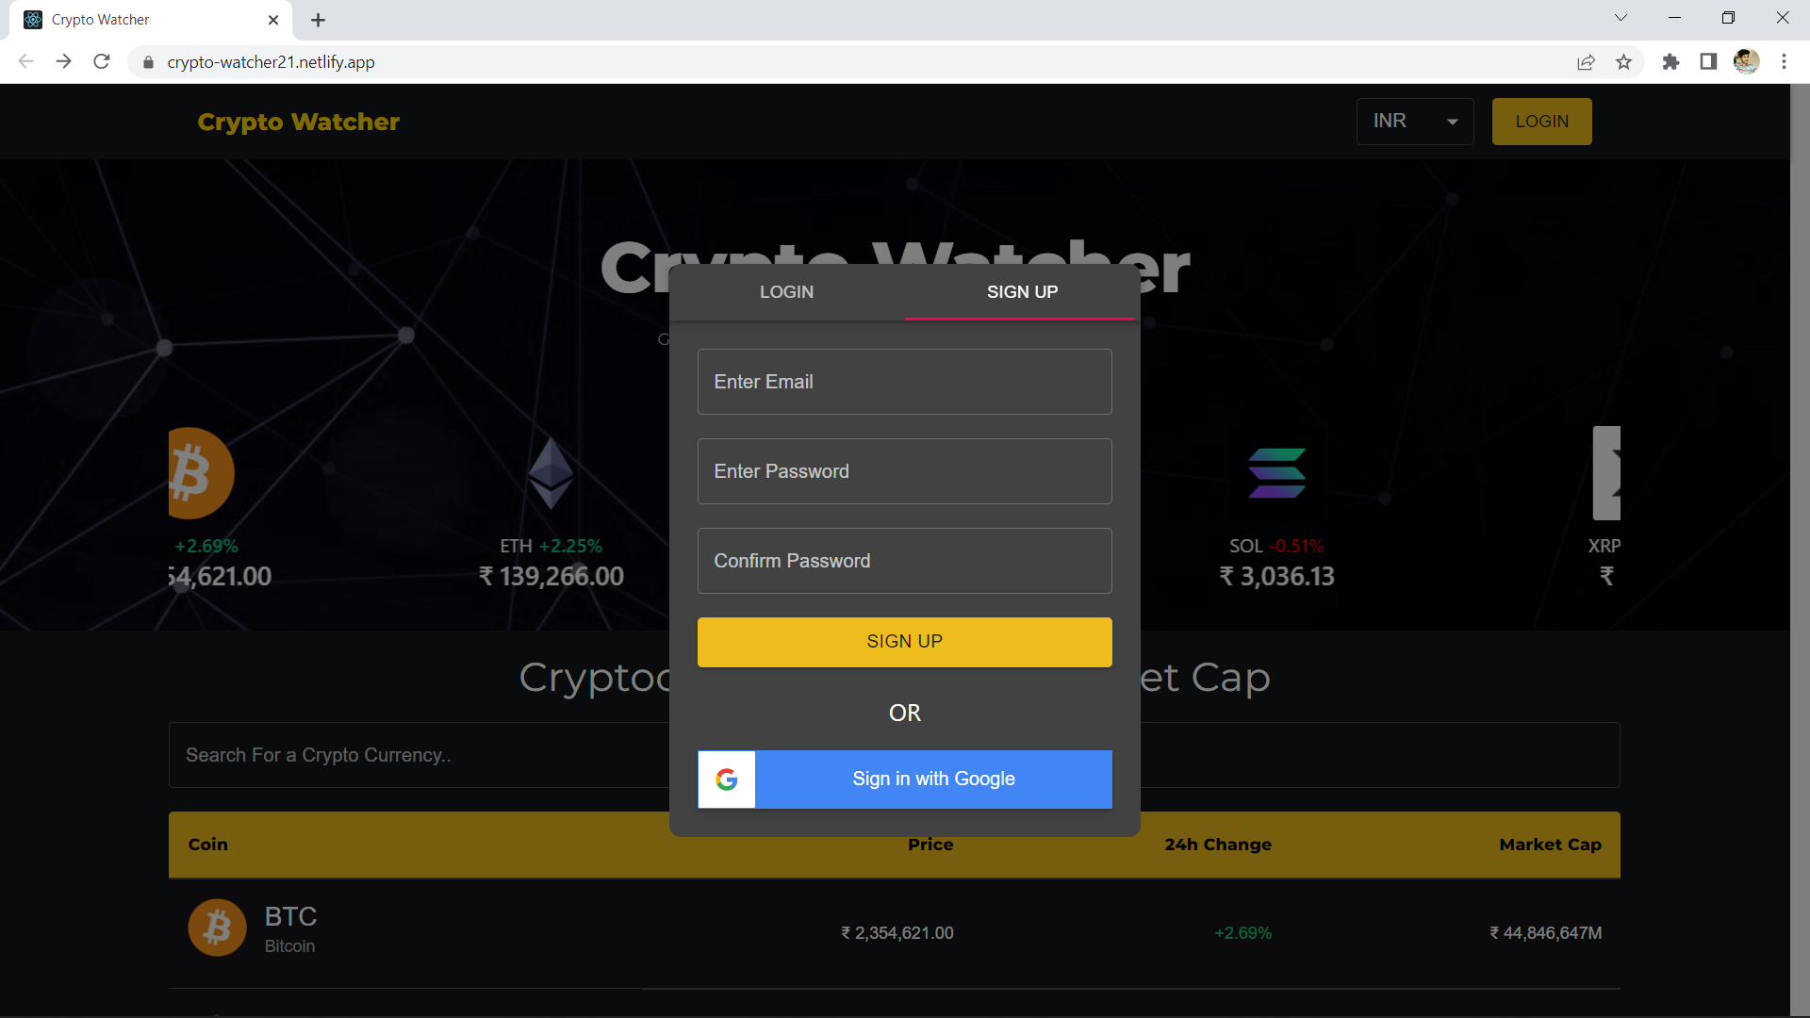
Signup Page

Slide 15
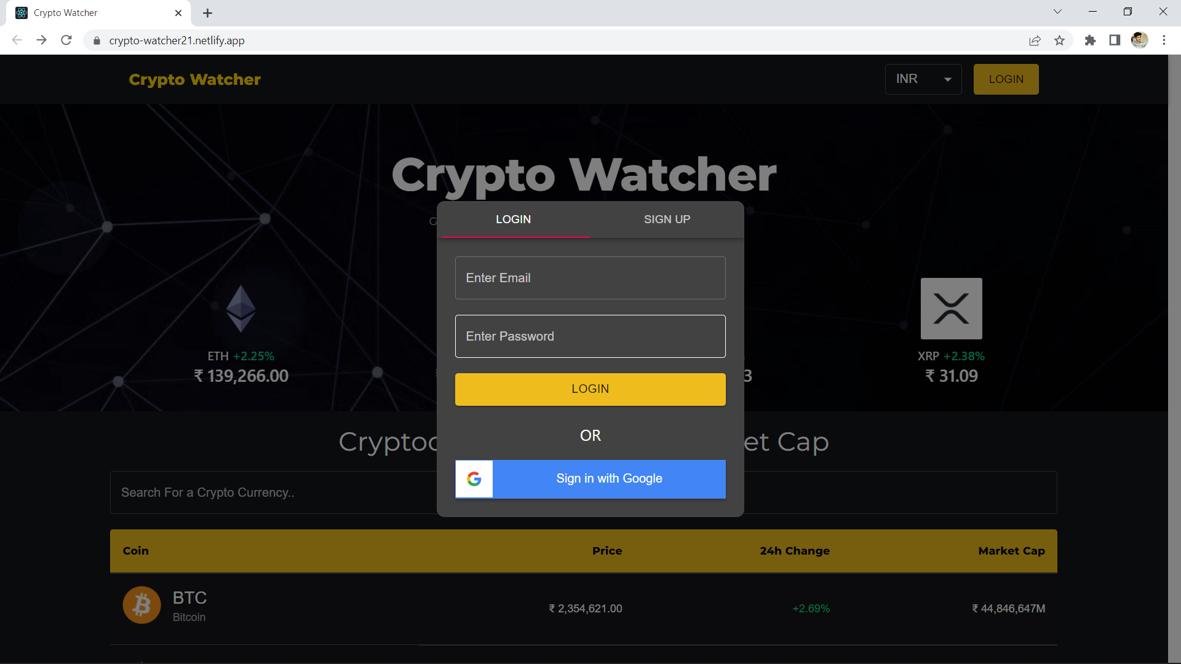
Login Page

Slide 16
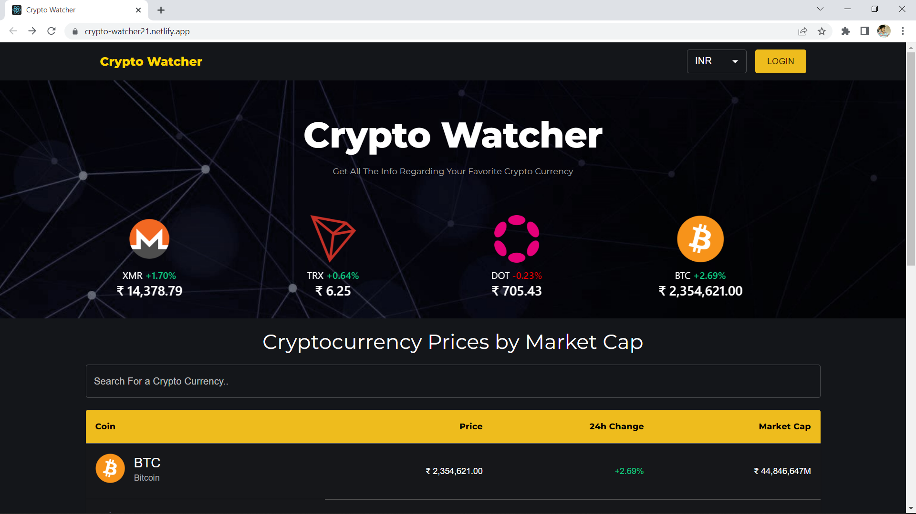
Homepage

Slide 17
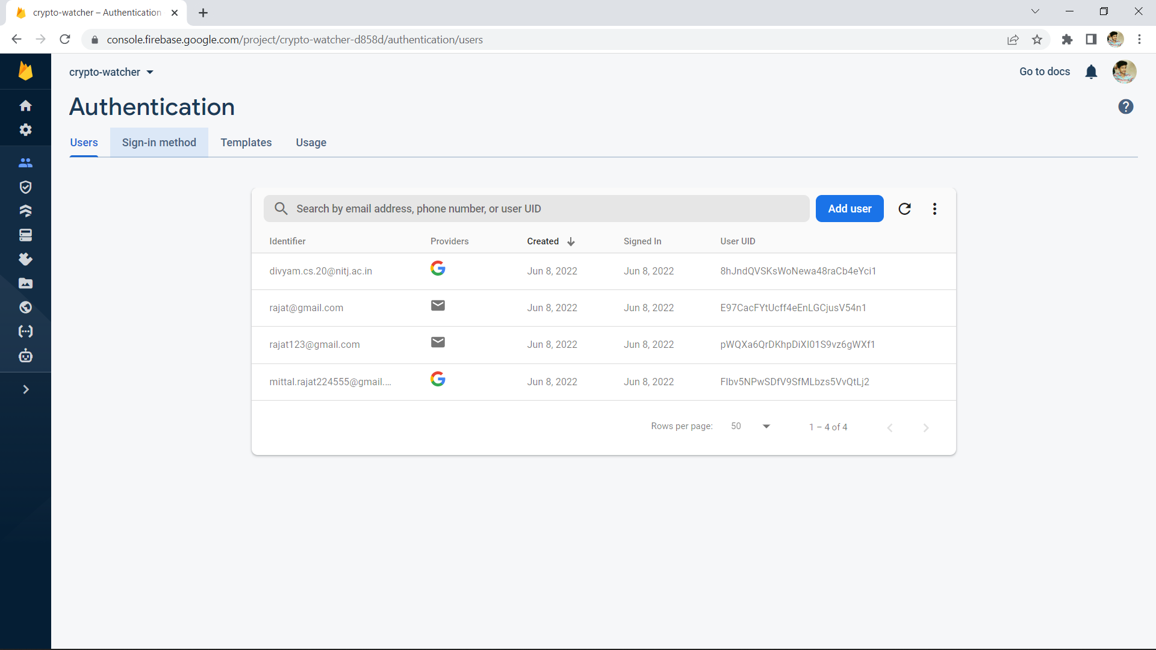
DATABASE

Slide 18
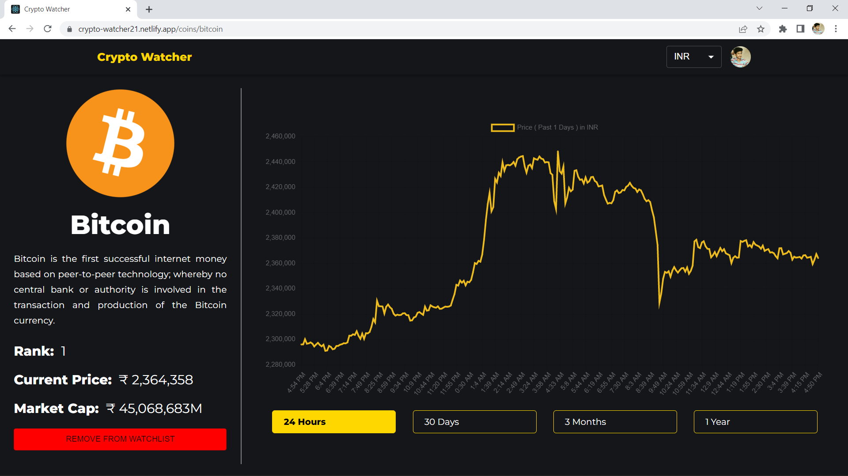
COIN INFO

Slide 19
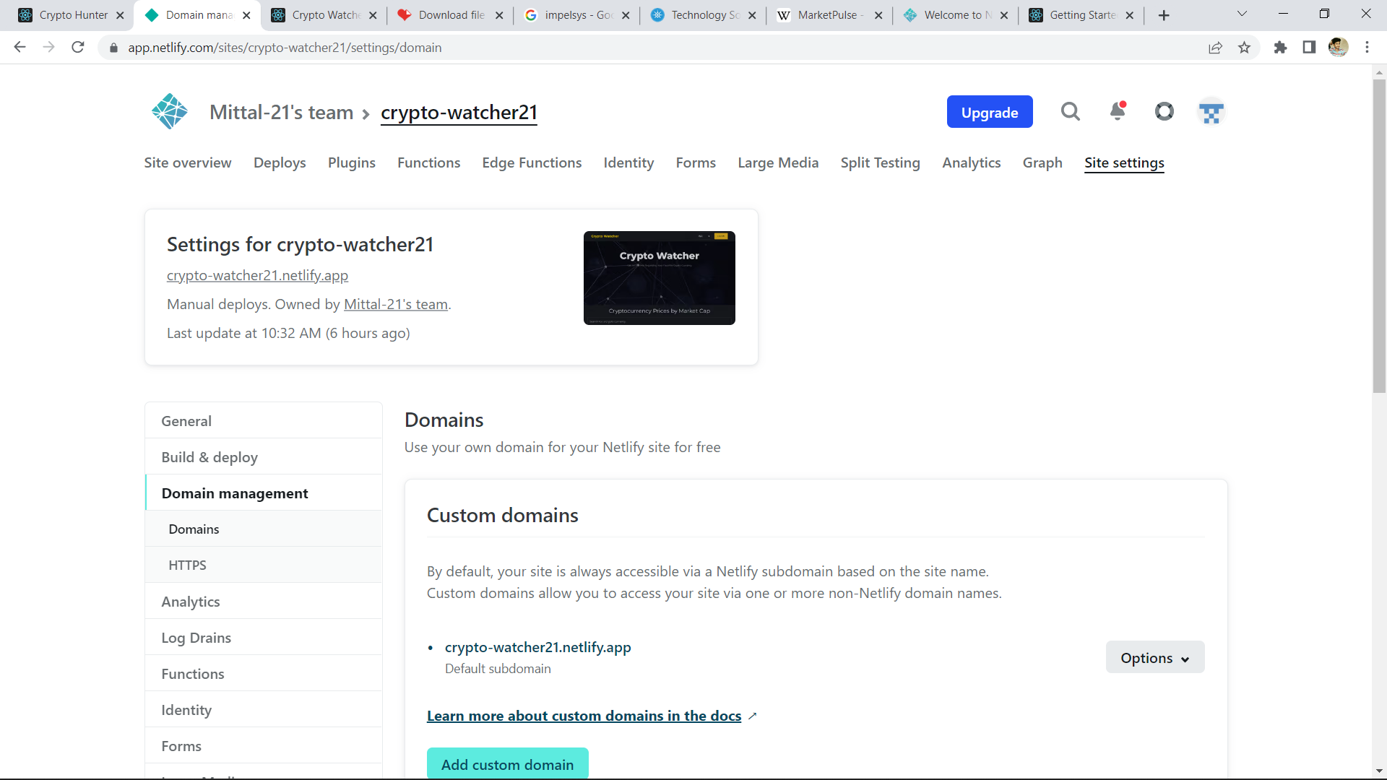
NETLIFY

Slide 20
Crypto Watcher USEFULNESS
This Website will be save both time and resources.
This will increase the interest of people towards digital currency
Responsive Design.
It will be a Website so no extra resources required.

Slide 21
THANKYOUu

